Slide 1

Gilbert’s Poker
Mobile
Main Menu
gilbertalba3.com
Willard 'Boot-Licker' Gill
$$
Carl 'Sundown' Herman
$$
Marshall 'Noose' Moore
$$
Player
$$

Slide 2
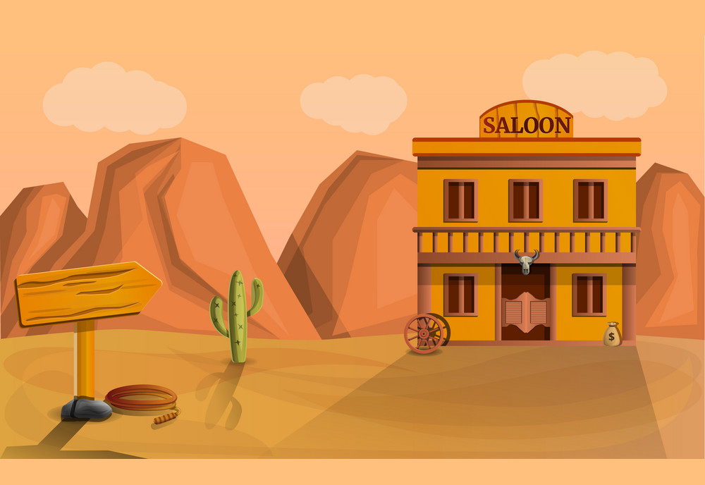
Howdy, partner!
Desktop
Mobile
Welcome to Gilbert’s Poker! If you’d like to take part in a game, you’ll have to sign in.
First name:
Last name:
Nick name:
Submit
gilbertalba3.com

Slide 3
Gilbert’s Mobile Poker
Desktop
gilbertalba3.com
Main Menu
Carl 'Sundown' Herman
$$
Willard 'Boot-Licker' Gill
$$
Player
$$
Marshall 'Noose' Moore
$$

